Slide 1



Using AI and Crowdsourcing to Simplify COVID-19 Info Worldwide
John Rochford
Program Director & Faculty Member
Eunice Kennedy Shriver Center
Invited Expert
World Wide Web Consortium
American Expert Speaker
U.S. State Department

Slide 2

EasyCOVID-19 Goals
Make the world healthier and safer.
Make COVID-19 info understandable
by every country’s huge populations of people with cognitive disabilities, low literacy, non-native language speakers, the Deaf, and seniors.
Make accessible, to the blind, COVID-19 info graphics; test and vaccine center finders.
Recruit world citizens to help us do all that.

Slide 3
EasyCOVID-19 Team Members
Aurom
Ben
Harika
Han
Jatin
Jenn
Katya
Kirsten
Miki
Carmen
Nate
Natalie
Shravya
Viet
Yeonju
Zhou
People From:
China, Ghana, India, Italy, Japan, Russia, South Korea, Vietnam, U.S.
People With:
Cognitive and physical disabilities.

Slide 4
EasyCOVID-19 Primary Goal
Make COVID-19 info
so simple
we understand it the
first time
we read it.

Slide 5
WHO, Strategy Update, April 2020
Without careful planning, and in the absence of scaled up public health and clinical care capacities, the premature lifting of physical distancing measures is likely to lead to an uncontrolled resurgence in COVID-19 transmission and an amplified second wave of cases.
Source

Slide 6
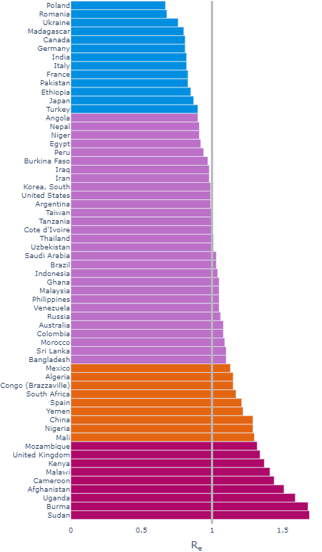
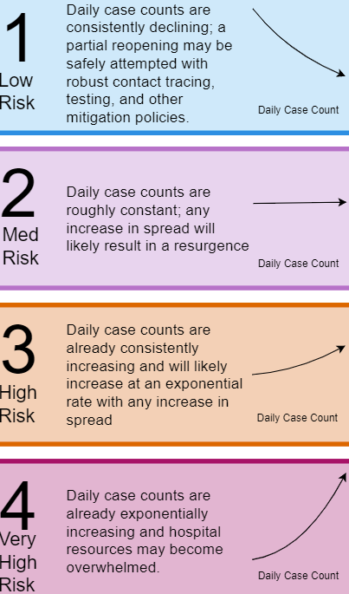
Resurgence Risk, Most Populous Countries, June 2021
Source
Notes:
Low Risk (13 Countries): Daily case counts are consistently declining; a partial reopening may be safely attempted with robust contact tracing, testing, and other mitigation policies.
Medium Risk (29 Countries): Daily case counts are roughly constant; any increase in spread will likely result in a resurgence.
High Risk (9 Countries): Daily case counts are already consistently increasing and will likely increase at an exponential rate with any increase in spread.
Very High Risk (9 Countries): Daily case counts are already ecponentially increasing and hospital resources are overwhelmed.

Slide 7
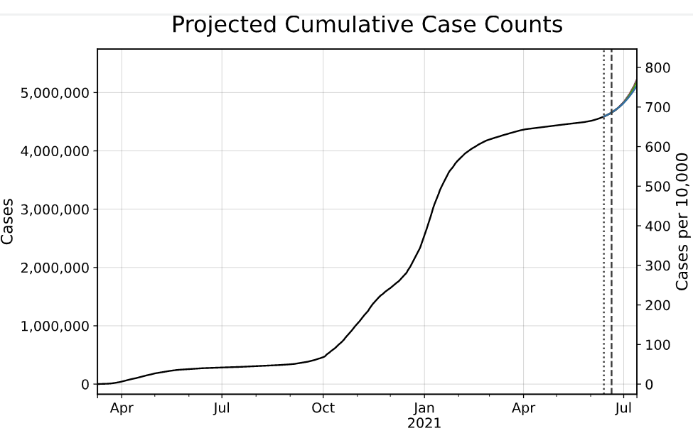
United Kingdom, June 2021

Slide 8

EasyText.AI Machine Learning Model: Technologies
Neural Machine Translation
Typical web text sentences and
simplified ones as distinct languages.
COVID-19 Knowledge Graph
We are creating a KG to train our model and for the world.
Generative Adversarial Network
Generator of web text examples using operationalized plain language guidelines (OPLG).
Discriminator that judges examples using OPLG.

Slide 9
Crowdsourcing Procedures
Recruit 1000s of people from every country.
Guide them to simplify text from government websites.
Help them replace non-literal text and biased text.
Ask them to rate text simplified by other crowdsourcers.
Incentive them with gamification.

Slide 10
Crowdsourcing Introduction Page
Please simplify as many COVID-19 terms as you can.
Think about how:
you would explain the term to a child.
your version would replace the term in a sentence.
Examples:
"people with COVID-19" not "confirmed cases"
"stay safe at home" not "quarantine"

Slide 11
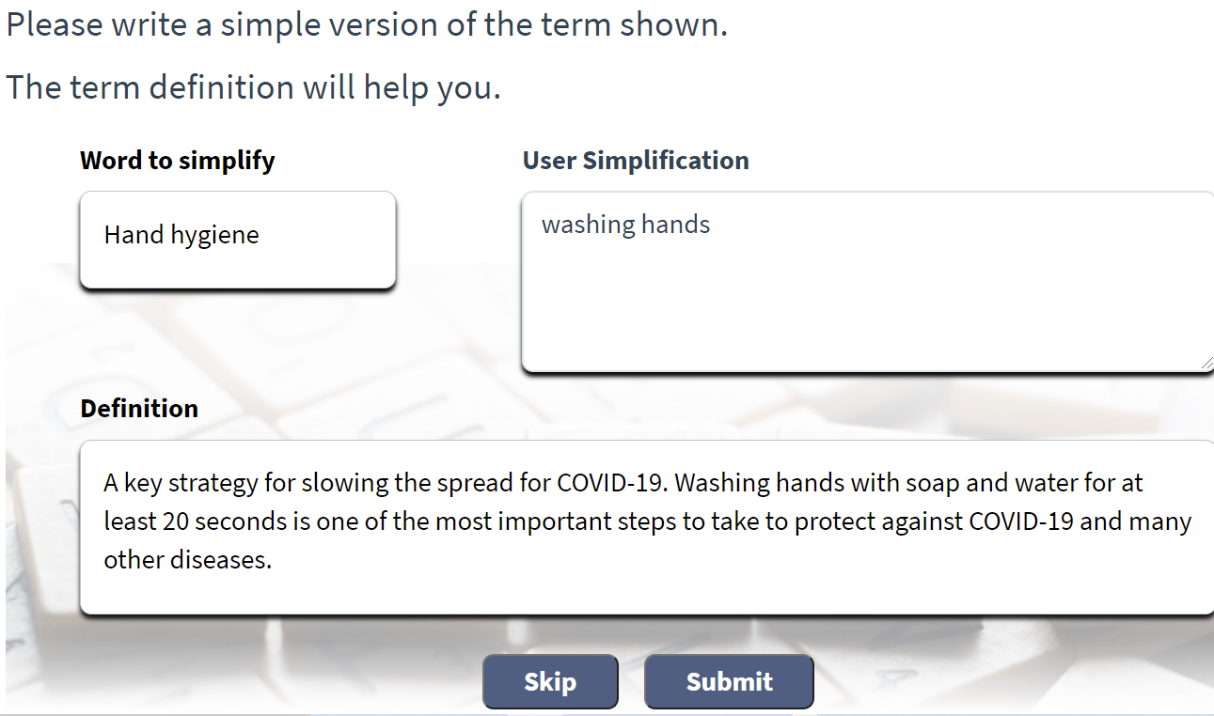
Crowdsourcing Example

Slide 12

EasyCOVID-19 Project Stages
Stage 1/Pilot: Massachusetts
Augment DisabilityInfo.org with:
easy-to-understand COVID-19 text
accessible test- and vaccine finders
Stage 2: All U.S. states
Stage 3: 18 native-English speaking countries
Stage 4: 21 native-Spanish speaking countries
Stage 5: All countries, official languages

Slide 13
EasyCOVID-19 Partners and Other Projects
Global Symbols
Create symbols to aid comprehension with contextually relevant images.
Diffbot
Develop a knowledge graph to train our ML model and for the world.
Twitter Academic Research Network.
Detect and notify local communities of outbreaks, new strains, clusters.
Open AI
Explore a tool that summarizes text to configurable reading-grade levels.
Fizz Studio
Create data-driven COVID-19 graphs accessible to the blind.

Slide 14

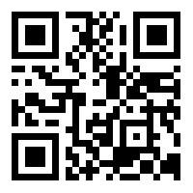

EasyCOVID-19
Websites
EasyCOVID-19.org
EasyText.AI
Presentation
bit.ly/WebSci2021

